Slide 1




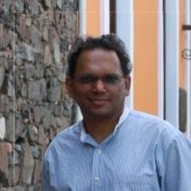
DeepMTL: Deep Learning Based Multiple Transmitter Localization
Caitao Zhan, Mohammad Ghaderibaneh, Pranjal Sahu, Himanshu Gupta

Slide 2
CONTENTS
Introduction
Problem
Solution
Evaluation
Conclusion

Slide 3
1 Introduction
The RF spectrum is a limited natural resource in great demand
US frees up 100MHz previously military occupied mid-band 3.45-3.55 GHz spectrum
US proposes the shared spectrum paradigm to increase utilization
Software-defined radio (SDR) technology gives people easy access to RF spectrum, both receive and transmit
Security threat! Selfish users can transmit data on shared spectrum without authorization
Find out all the unauthorized transmissions harnessing deep learning
Title → DeepMTL: Deep Learning Based Multiple Transmitter Localization
Notes:
a) due to the increase in mobile (and hence, wireless) data consumption

Slide 4

2 Problem: Multiple Transmitter Localization (MTL)
Location?
Transmitter
Sensor
y
x
Notes:
The sensors will sense the wireless channel of interest and process the wireless signals. Then sensors compute the received signal strength.

Slide 5
2.1 MTL Problem Definition & Challenges
Consider a geographic area, assume a single channel.
Distribute a set of crowdsourced sensors. They report RSSI.
There are multiple transmitters, including both legal and illegal ones
MTL Definition: Given the observations from the sensors, localize all the transmitters present.
Challenges:
Sensor receives only a sum of the signals from the multiple TXs transmitting simultaneously.
Multiple targets to localize, some might be close to each other.

Slide 6
2.2 Compare DeepMTL with Prior Work
Solution | Conference | Summary / Limitations
SPLOT | MobiCom 2017 | Logistic regression-based method. Can not localize two nearby transmitters.
MAP* | IPSN 2020 | Bayesian-based method with divide-and-conquer technique. High computational cost and high latency.
DeepTxFinder | ICCCN 2020 | Deep learning-based method (CNN). # of CNN models is linear to # of transmitters (not scalable, inelegant) Results not good.
DeepMTL | WoWMoM 2021 | Deep learning-based method (CNN). Constant two CNN models (scalable, elegant). Results a lot better.

Slide 7
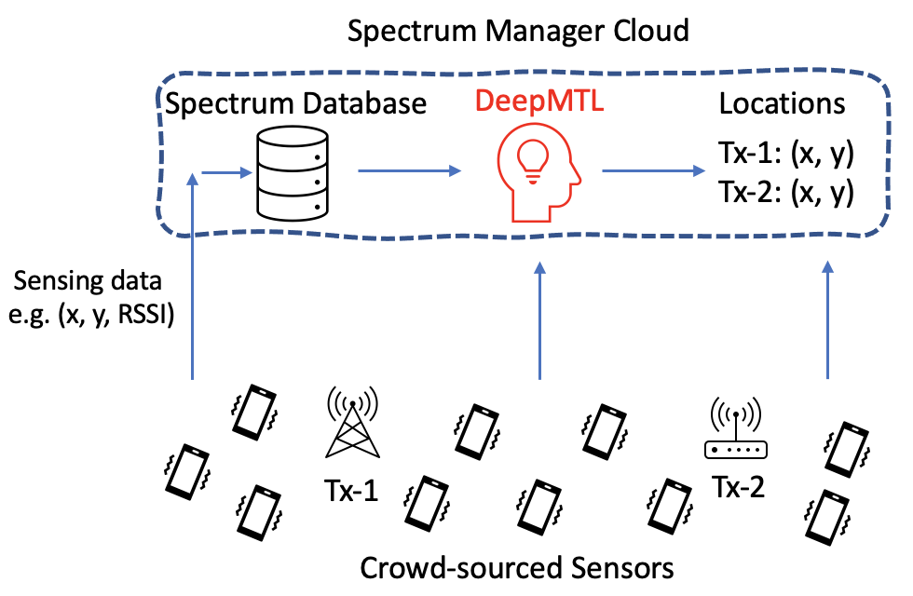
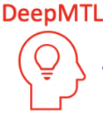
3 Solution Overview – Input/Output & Architecture
Input
sensor1: (x1, y1, RSSI1)
sensor2: (x2, y2, RSSI2)
sensor3: (x3, y3, RSSI3)
…
Output
Tx1: (x1, y1)
Tx2: (x2, y2)

Slide 8
3.1 Core Idea: a Two Step CNN-based Method
Input
sensor1: (x1, y1, RSSI1)
sensor2: (x2, y2, RSSI2)
sensor3: (x3, y3, RSSI3)
…
Step 1
Represent the input sensor readings as an image
Apply image-to-image translation CNN model
Step 2
Output
Tx1: (x1, y1)
Tx2: (x2, y2)
Apply object detection CNN model

Slide 9
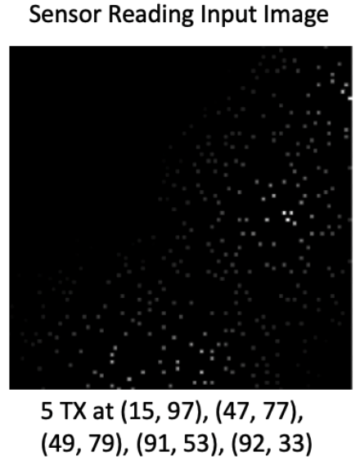
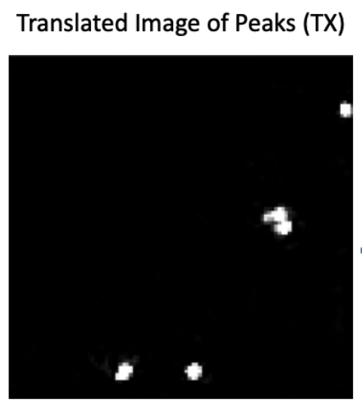
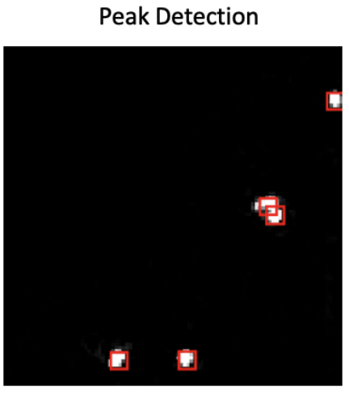

3.2 Illustration of the Two-Step Core Idea
CNN-1
CNN-2
Step 1: image to image translation
Step 2: object detection

Slide 10
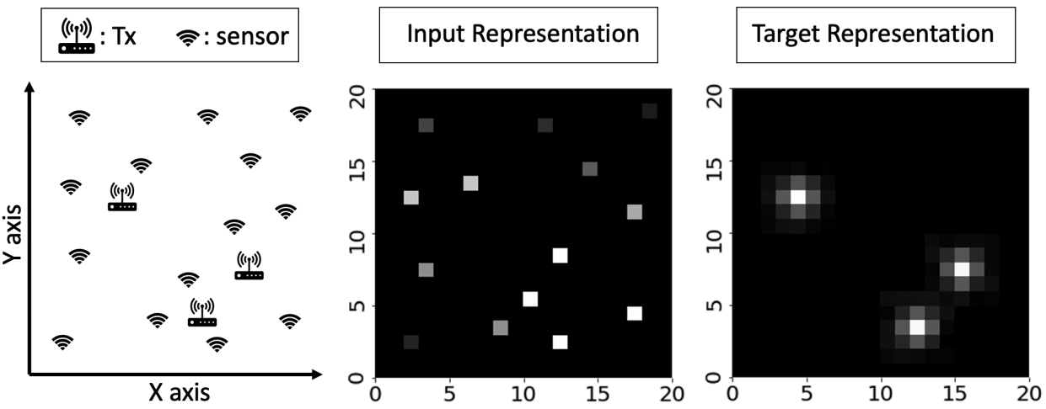
3.3 Step 1: Image to Image Translation
Input / Output Representation
Gaussian
Peak

Slide 11
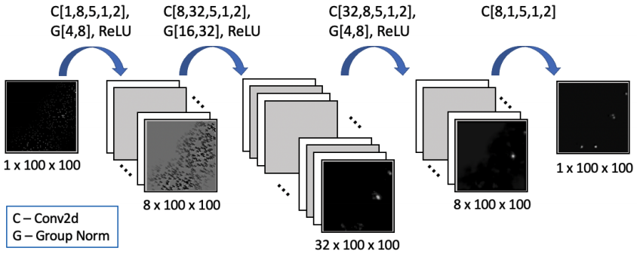
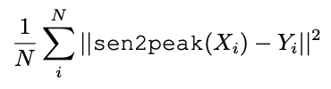
3.4 Step 1: Image to Image Translation
sen2peak: the CNN model
Loss function
C[input-channel, output-channel, kernel-size, stride, padding]
G[number-of-groups, number-of-channels]

Slide 12
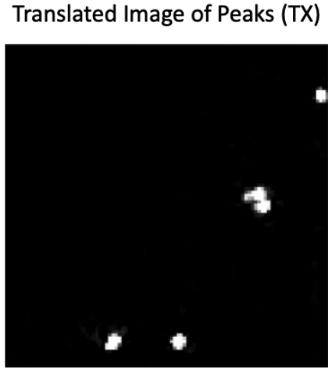
3.5 Step 2: Peak Detection
Given an image of TX distributions (output of step 1). Find the peaks, where each peak denotes a TX
A simple way: use a local maxima-based method (maximum pixel value within a circle of a certain radius)
Problem: Setting the radius value and the threshold for peaks is ad-hoc
Need a more intelligent method. Resort to deep learning

Slide 13
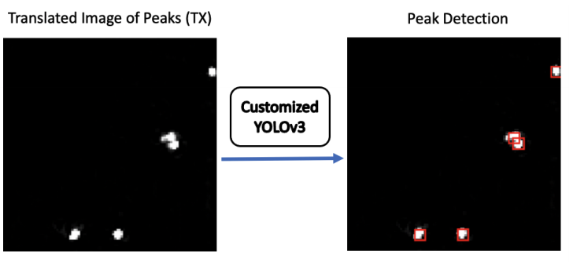
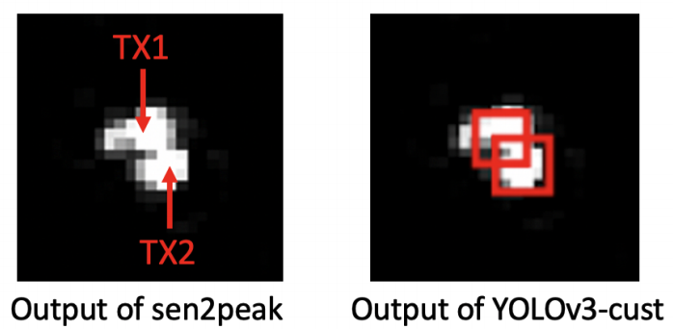
3.6 Step 2: Peak Detection
YOLO (You Only Look Once): An advanced and popular object detection method. Object detection is localizing objects in an image
A TX’s distribution is a peak. We view a peak as an object. Then the idea of applying an object detection method naturally comes
We tailor the YOLOv3 and introduces YOLOv3-cust
The output of YOLOv3-cust are the coordinates of the center of the red bounding boxes

Slide 14
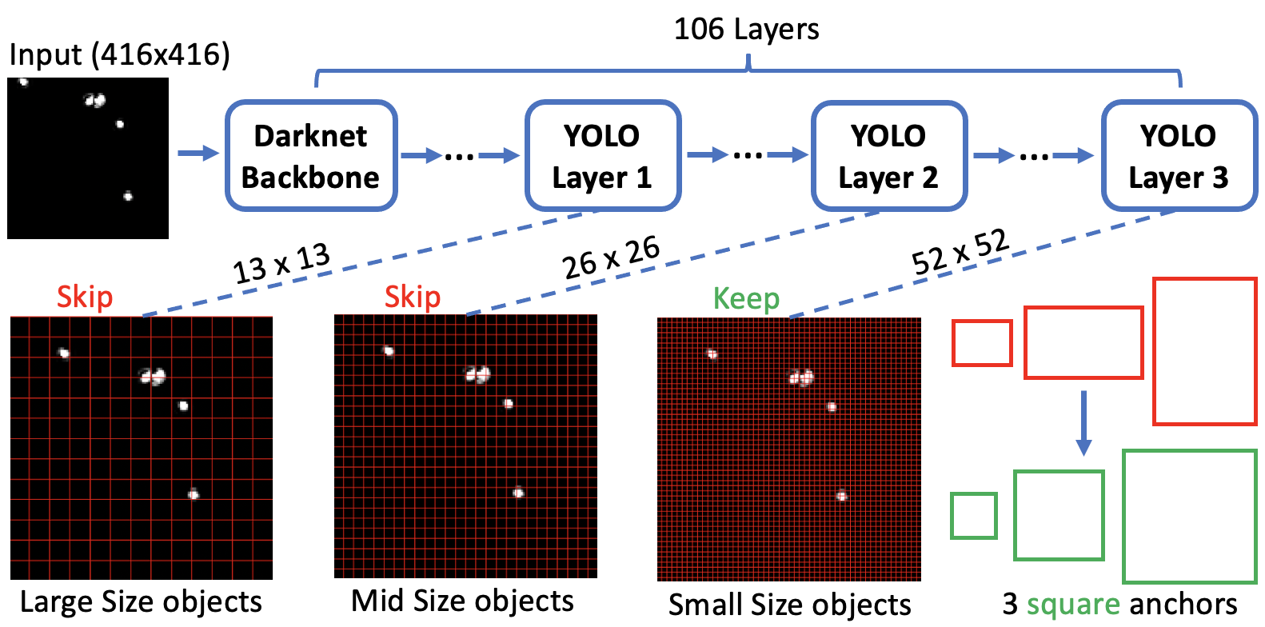
3.7 Step 2: Peak Detection
A closer look at the YOLOv3-cust
Two major customizations
Skip the first two YOLO layer. i.e., don’t use it to predict the bounding boxes
Change the anchors from rectangle to square

Slide 15
4 Evaluation -- Setup
Data generated using a simulator called SPLAT!
~100K samples for training and ~20K samples for testing
Performance metrics:
Localization error
Miss rate
False alarm rate
Running time
A geographical area of 1km x 1km, a 100x100 grid, a cell is 10m x 10m
Default parameters:
# TX = 5
Sensor density = 6%

Slide 16
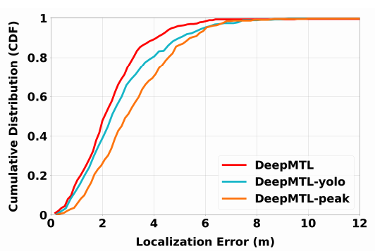
4.1 Compare Localization Error of Three Different Step 2 Methods (sharing the same step 1)
DeepMTL: use customized YOLOv3
DeepMTL-yolo: use the original YOLOv3
DeepMTL-peak: use naive peak detection

Slide 17
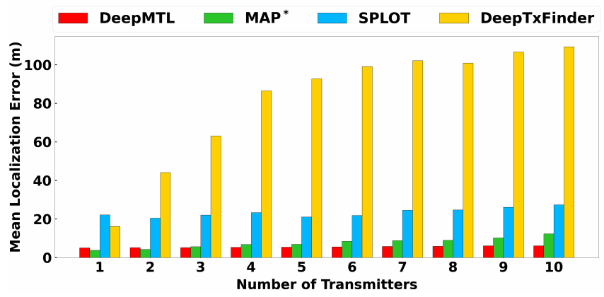
4.2 Compare Localization Error (Varying # of TX)
Compare our proposed DeepMTL with MAP*, SPLOT and DeepTxFinder

Slide 18
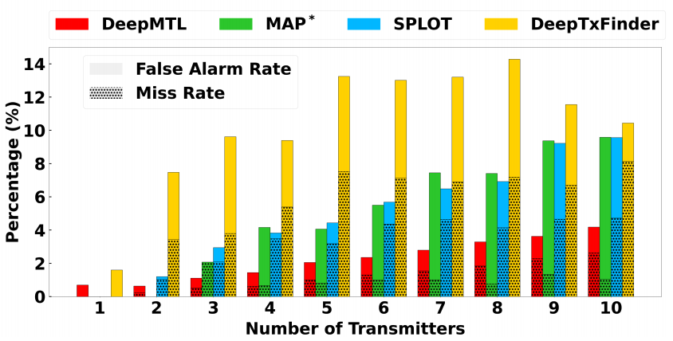
4.3 Compare False Alarm & Miss rate (Varying # of TX)
Compare our proposed DeepMTL with MAP*, SPLOT and DeepTxFinder

Slide 19
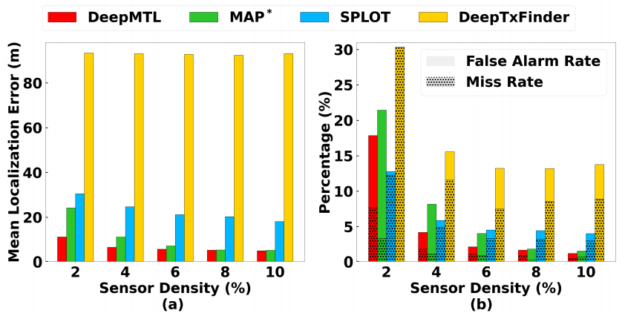
4.4 Compare Localization Error, False Alarm Rate & Miss Rate (Varying Sensor Density)
Compare our proposed DeepMTL with MAP*, SPLOT and DeepTxFinder

Slide 20
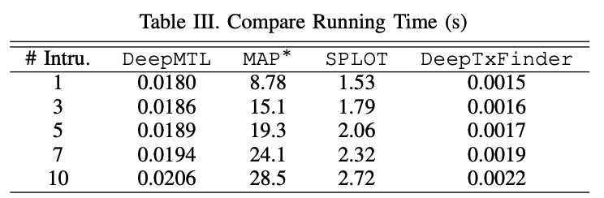
4.5 Compare Running time (Varying # of TX)
Compare our proposed DeepMTL with MAP*, SPLOT and DeepTxFinder

Slide 21
4.6 Comparing DeepMTL with DeepTxFinder
Q: Both are deep learning-based methods. Why DeepMTL is significantly better than the DeepTxFinder?
A: Because DeepTxFinder cannot accurately predict the # of transmitters. But DeepMTL can – with the help of an advanced object detector from the computer vision community.

Slide 22

5 Conclusion
Designed and implemented a novel 2-step deep learning based approach named DeepMTL for the multiple transmitter localization problem
The evaluation results show that our DeepMTL outperforms the prior work by a large margin.
Thank You For Listening! Feel Free to Ask Questions ~~
The paper and slides are at: https://caitaozhan.github.io/
The video is at: https://www.youtube.com/channel/UCaIn4Xvo3bJh24uxHIM9VIA
The code is at: https://github.com/caitaozhan/deeplearning-localization

